Slide 1
Project
MY OWN TV CHANNEL
Made by
Grakholskaya Julia
Form 9 «A»

Slide 2
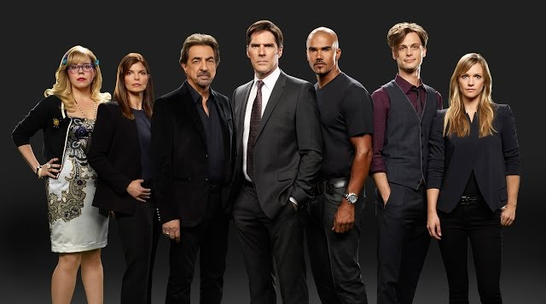
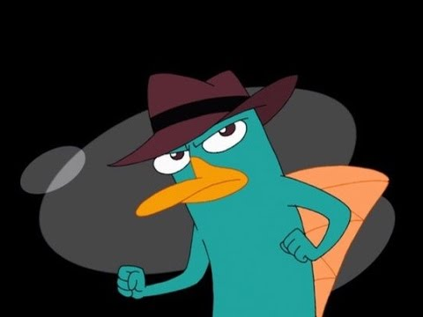
My channel will be called “MY“. To tell the truth, I couldn't think a good name, but I really tried. I’d like to show cartoons, detective stories and sometimes good films. I like them. After all, I am a creator and overlord of this channel. That’s why I can do what I want.

Slide 3
Advertisements? Of course I will show them. After all, I'll have to earn money to develop my channel. Moreover, advertising has its pluses. You can quickly run to the fridge and take something tasty to eat.

Slide 4
Slogan of the channel is «MY» is yours.
Thank you for your attention

