Slide 1
MY OWN CHANNEL
Made: Gadzhieva Sonya. 9A form

Slide 2
We all sometimes watch TV

Slide 3
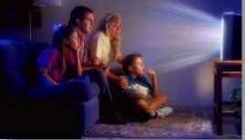
It takes an important part in our life

Slide 4
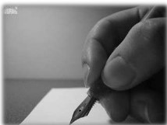
If I could create my own channel, so of course I would be an editor. But only for the first time

Slide 5
The first is:
There would be three main directions.
«interesting facts around us»

Slide 6
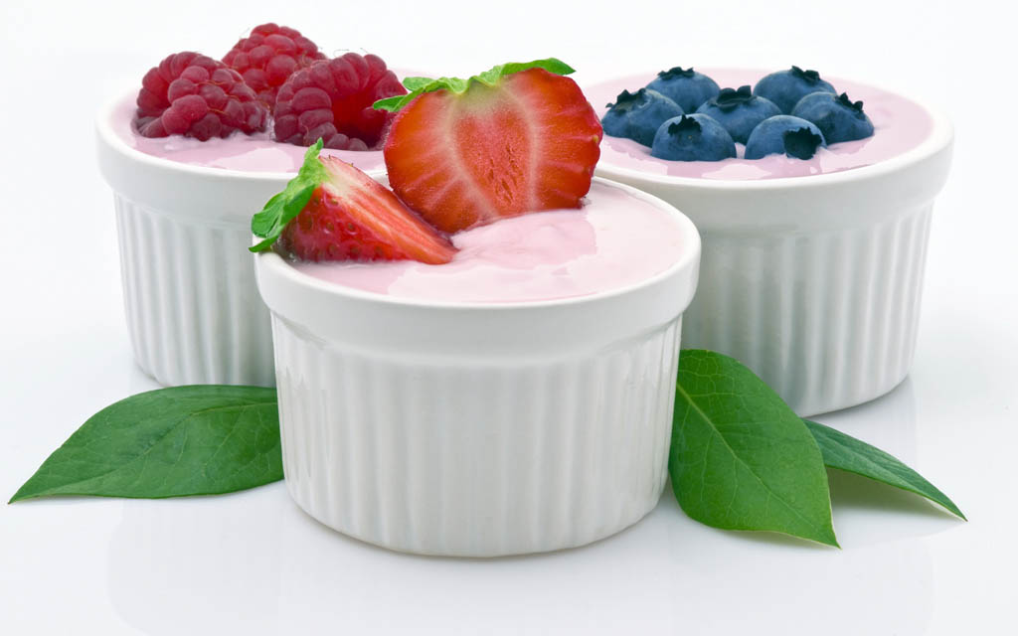
FOR EXEMPLE:
Yogurt got its name from the Turkish word which means long life.

Slide 7
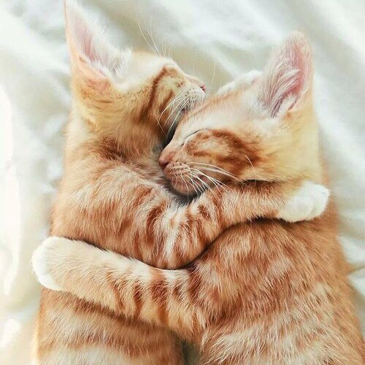
PHILOPHOBIA
Fear of emotional attachment; fear of being in or falling in love

Slide 8
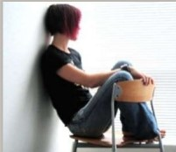
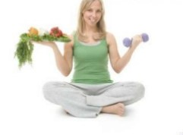
«What are we?»
The second: I would be talk about fears, phsychological complexes, relationships and health

Slide 9
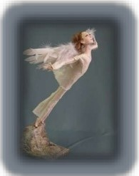

Slide 12
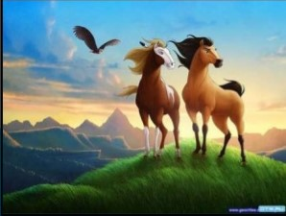
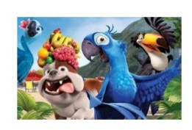

Slide 14
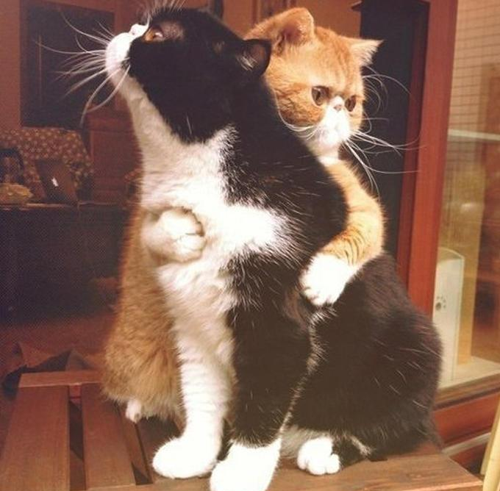
THANK YOU FOR ATTENTION

